Slide 1
Self Organization Maps
Bhuvaneshwari Patil

Slide 2
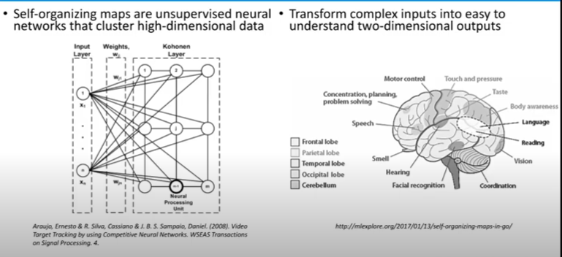
Self Organizing maps

Slide 3
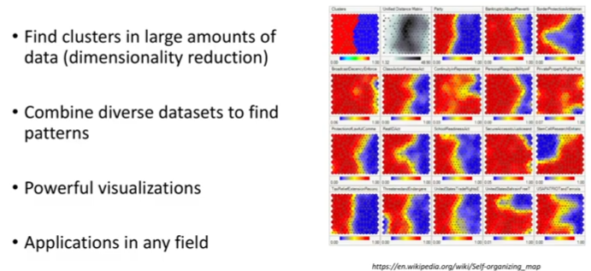
Why to use SOM?

Slide 4
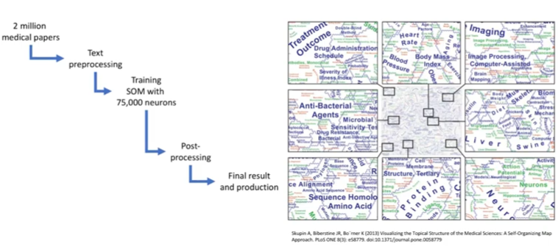
Clustering in Medical field

Slide 5
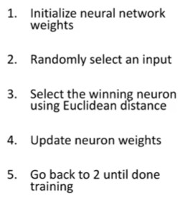
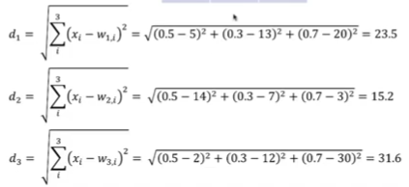
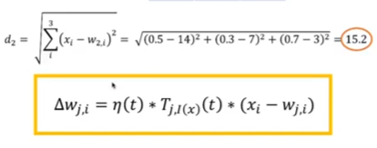
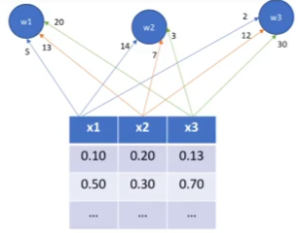
Training Process

Slide 6
What is a Model Parameter?
A model parameter is a configuration variable that is internal to the model and whose value can be estimated from data.
They are required by the model when making predictions.
They values define the skill of the model on your problem.
They are estimated or learned from data.
They are often not set manually by the practitioner.
They are often saved as part of the learned model.
Parameters are key to machine learning algorithms. They are the part of the model that is learned from historical training data.
Often model parameters are estimated using an optimization algorithm, which is a type of efficient search through possible parameter values.

Slide 7
What is a Model Hyperparameter?
A model hyperparameter is a configuration that is external to the model and whose value cannot be estimated from data.
They are often used in processes to help estimate model parameters.
They are often specified by the practitioner.
They can often be set using heuristics.
They are often tuned for a given predictive modeling problem.
We cannot know the best value for a model hyperparameter on a given problem.
We may use rules of thumb, copy values used on other problems, or search for the best value by trial and error.

Slide 8
hyperparameters
Some examples of model hyperparameters include:
The learning rate for training a neural network.
The C and sigma hyperparameters for support vector machines.
The k in k-nearest neighbors.
“Many models have important parameters which cannot be directly estimated from the data. For example, in the K-nearest neighbor classification model … This type of model parameter is referred to as a tuning parameter because there is no analytical formula available to calculate an appropriate value”.
— Page 64-65, Applied Predictive Modeling, 2013
If you have to specify a model parameter manually then it is probably a model hyperparameter

Slide 9
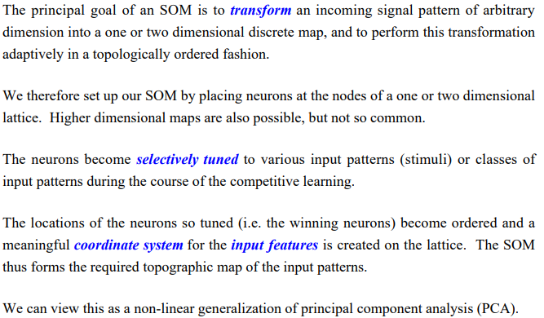
Setting up a Self Organizing Map

Slide 10
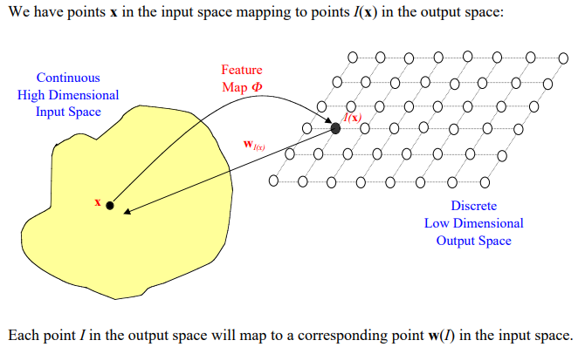
Organization of the Mapping

Slide 11
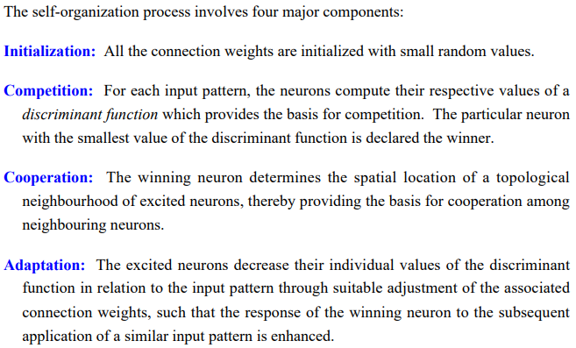
Components of Self Organization

Slide 12
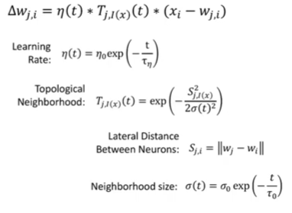
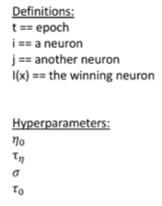
Weight update function
Magnifying learning rate
Ranges between 0 to 1
Helps in clustering

Slide 13
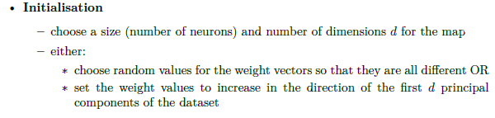
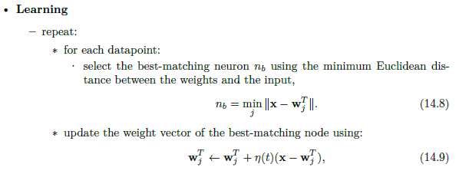
The Self-Organising Feature Map Algorithm

Slide 14
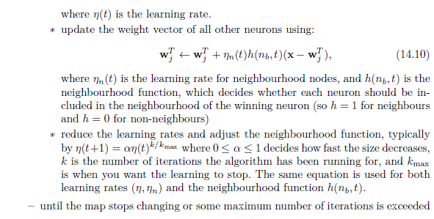
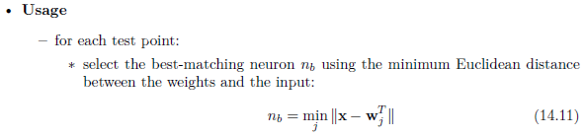
The Self-Organising Feature Map Algorithm

Slide 15
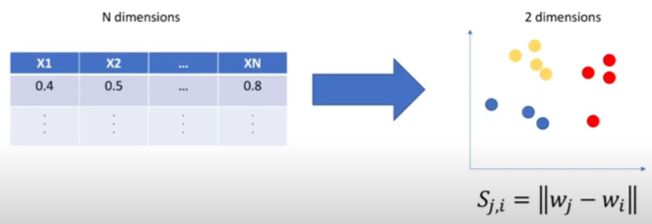
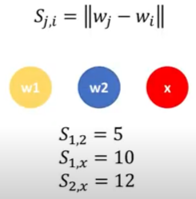
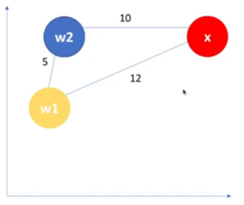
Dimensionality Reduction

